Slide 1
JAVA

Slide 2
What is JAVA?
When Java developed?
How Java runs?
Why Java?
Who are all using Java?
?

Slide 3
INTRODUCTION:
It is Object Oriented Programming language
James Gosling-1995
Sun Microsystem → Oracle on 2009
Platform independent
JDK – Java Development Kit
IDE – Integrated Development Environment

Slide 4
FEATURES OF JAVA
Open source- free
WORA- Write Once Run Anywhere
Portable
Distributed and secure
Compiled and then Interpreted

Slide 5
How Java Runs:
Byte Code
I/P
Source Code
Compiler
Hello.class
Hello.java
O/P
JVM

Slide 6
Applications of Java:
Desktop GUI Applications
Web applications
Mobile Applications
Gaming applications
Big Data technology
Cloud Applications
Artificial Intelligence

Slide 7
Types of JAVA:
J2SE → Standard Edition
J2EE → Enterprise Edition
J2ME → Micro Edition
JRE
JVM
JRE
JDK
JRE → Java Runtime Environment
JVM → Java Virtual Machine

Slide 8
Basic Program:
package Programs;
public class First
{
public static void main(String[] args)
{
System.out.println("welcome to Eclipse");
}
}

Slide 9
Variables:
Naming a storage location to access the stored data.
Variable declaration:
int a = 10;
Types:
Local variable → Inside main method
Static variable → static keyword
Instance variable → Inside class
a
0
1 0 1 0

Slide 10
Data Types:
What kind of data we are storing and how much space it needs is denoted using data types.
Types:
Primitive – Standard Datatype
Non-Primitive – Derived Datatype
Note: It will store the data in machine language(0,1).
So, every 0 or 1 is 1 bit and 8 bits = 1 byte

Slide 11
Data type:
Data Type: Default size
byte(numbers) 8 bit - 1 byte
Boolean(true, false) 8 bit - 1 byte
char(alphabets, symbols) 16 bit - 2 byte
short(num bers) 16 bit - 2 byte
int (numbers) 32 bit - 4 byte
long(numbers) 64 bit - 8 byte
float(point values) 32 bit - 4 byte
double(point values) 64 bit - 8 byte

Slide 12
Operators:
A symbol like(+) used to perform operations like adding two numbers.
Arithmetic Operator
Assignment Operator
Relational Operator
Increment/Decrement Operator
Logical Operator
Conditional Operator

Slide 13
Arithmetic Operator:
Operator | Operation
+ | Addition
- | Subtraction
* | Multiplication
/ | Division
% | Modulo Operation (Remainder after division)

Slide 14
Assignment Operator:
Operator | Example | Equivalent to
= | a = b; | a = b;
+= | a += b; | a = a + b;
-= | a -= b; | a = a - b;
*= | a *= b; | a = a * b;
/= | a /= b; | a = a / b;
%= | a %= b; | a = a % b;

Slide 15
Relational Operator:
Operator | Description | Example
== | Is Equal To | 3 == 5 returns false
!= | Not Equal To | 3 != 5 returns true
> | Greater Than | 3 > 5 returns false
< | Less Than | 3 < 5 returns true
>= | Greater Than or Equal To | 3 >= 5 returns false
<= | Less Than or Equal To | 3 <= 5 returns true

Slide 16
Increment / Decrement:
Operators Example Description
a++ a+1 post- increment
++a 1+a pre-increment
a-- a-1 post – decrement
--a 1-a pre - decrement

Slide 17
Logical Operator:
Operators Example Description
AND- && a>b && a++>c If any one condition is False then False
OR - || a>b || a++>c If any one condition is True then True
Conditional Operator:
variable = Expression ? expression1 : expression2;
int Min = (a<b) ? a : b ;
boolean answer = (a!=b) ? True : false ;

Slide 18
User Input:
To get user input we need to use one predefined class called Scanner.
This class is present in java.util package.
Example:
import java.util.Scanner; pre-defined class
Scanner sc = new Scanner(System.in); Object
int a = sc.nextInt(); pre-defined function
double d = sc.nextDouble();

Slide 19
Decision Contructs:
To change the flow of the program
Conditional Branching
To check the condition right or wrong.
Conditional Looping
To repeat the process with conditions.
Unconditional Control Statement
Jump statement.

Slide 20
Conditional Branching:
If Condition:
Syntax:
if(Condition)
{
//statement;
}
If – else Condition:
Syntax:
If(Condition) {
//Statements;
}
else {
//Statements;
}

Slide 21
Else-if Ladder:
Syntax:
if(condition1) {
//Statement1;
}
else if(condition2) {
//statemen2;
}
else if(condition3) {
//statemen3;
}
else {
//statement4;
}
Nested if:
Syntax:
if(condition1) {
if(condition2) {
//statement;
}
else {
//Statement;
}
}
else {
//statement;
}

Slide 22
Switch:
To Choose an particular option from a list of items or options which is considered as case.
Syntax:
switch(option)
{
case 1:
//statement;
break;
case 2:
//statement;
default:
//statement;
}

Slide 23
Conditional Looping:
1. for(initializer; condition; increment/decrement)
{
//statement;
}
2. while(condition)
{
//statement;
increment;
}
3. do
{
//statement;
increment;
}
while(condition);

Slide 24
Unconditional Statement:
Break:
Used to terminate the flow.
Keyword: break;
Continue:
used to continue after skipping the condition.
Keyword: continue;

Slide 25
Method(Function):
Small programs that will do particular task whenever we call using function call.
We can pass the value as a argument and get the value as parameter.
Syntax:
Returntype funName(Arguments)
{
//Statements;
}

Slide 26
Types of Functions:
With arguments With Return
Without arguments With Return
With arguments Without Return
Without arguments Without Return

Slide 27
ARRAY

Slide 28
Array:
Collection of Values in a single type.
Stored in index position and can access with the help of index positions.
Syntax:
Int[] a={10, 20, 30};
Int a[]= new int[size];
Int [] a;

Slide 29
Types of Array:
Single Dimensional → int[] a= {1,2,3 };
int[] a = new int[5];
Two Dimensional → int[][] a= {{1,2},{3,4} };
int[][] a = new int[2][3];
Three Dimensional → int[][][] c={{1,2},{3,4}, {5,6}};
int[][][] a = new int[2][2][2];

Slide 30
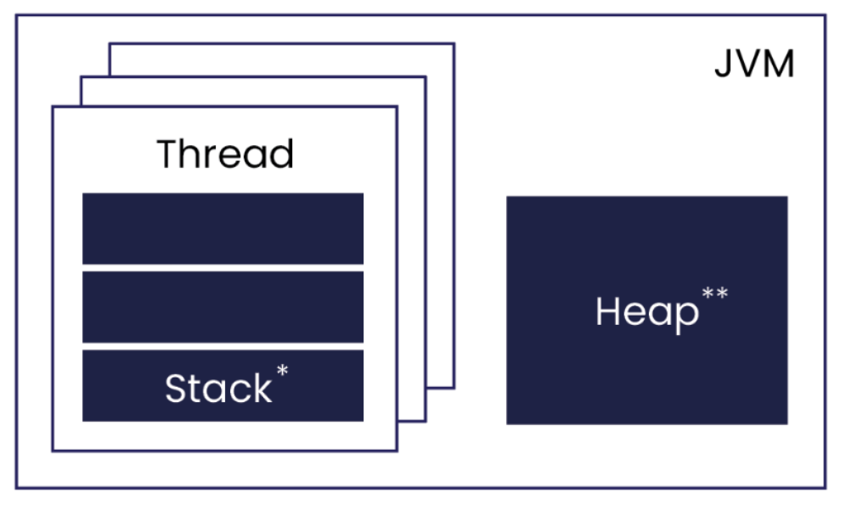
Memory Management:
Storing the Data in Memory.
Stack Memory → FILO
Heap Memory
It has SCP [String Constant Pool]

Slide 31
String Pool:
String pool is a pool of string which is stored in java heap memory.
String pool is possible only because strings are immutable.
Once it created it can’t be change.
Multiple thread can access the same string since, its immutable.
It is Thread safe.

Slide 32
String Handling

Slide 33
String:
String is a sequence of characters stores depend on index positions just like an array.
Example:
char name[]={‘L’,’I’,’V’,’E’,’L’,’O’,’N’,’G’,};
String s=new String(name);
System.out.println(s);
Output:
LIVELONG

Slide 34
String Operations:
.length();
.charAt();
.toUpperCase();
.toLowerCase();
.Concat();
S1.equals(s2);
s1.CompareTo(s2);
.repeat();
.endsWith();
.substring(8,12);
.trim();
.replace(“j”,”k”);

Slide 35
String Buffer:
Mutable and Automatically Grow if needed.
StringBuffer → Defult 16-bit
It adds 16 bit in every single bit addition.
It is Thread safe.
Syntax:
StringBuffer sb=new StringBuffer(“Hello There”);
sb.length();

Slide 36
StringBuffer Operation:
sb.append("Java");
sb.insert(1,"Java");
sb.replace(1,3,"Java");
sb.delete(1,3);
sb.reverse();
sb.capacity()
sb.ensureCapacity(50);

Slide 37
StringBuilder:
The java stringBuilder class is used to create mutable string.
Not thread safe.
String builder is faster than string buffer.
Example:
StringBuilder s=new StringBuilder(“java”);
System.out.println(s);

Slide 38
Access Modifier:
Public → We can access in anywhere
Private → Only accessible to particular places.
Protected → Access inside packages and inherited.
Defualt → Only can access in package.

Slide 39
OOPs

Slide 40
Object-Oriented Programming
Object-Oriented Programming is a methodology to design a program using…
1. Class 2. Object
3. Inheritance 4. Interface
5. Encapsulation 6. Abstraction
7. Polymorphism

Slide 41
Syntax:
Class:
<access-modifier> class <className> { }
Object:
<className> <objectName> = new <className>();
<objectName>.functioncall();

Slide 42
Program:
public class First {
public void status(String name, int model){
System.out.println("Name = "+name);
System.out.println("Model ="+model);
}
public static void main(String[] args){
First obj=new First();
obj.status("Audi", 2005);
obj.status("BMW", 2007);
}
}
Output:
Name = Audi
Model =2005
Name = BMW
Model =2007

Slide 43
Inheritance

Slide 44
Definition:
A class inherits the property of another class.
It motivates the code reusability.
Super Class → Parent Class → Base class
Sub class → Child class → Derived class
Syntax:
class <subclassName> extends <superclassName>
{
//Statement;
}

Slide 45
Types:
Single Inheritance.
Mutilevel Inheritance.
Hierarchy Inheritance.
Java doesn’t support Hybrid inheritance.
Multiple inheritance is achieved by Interface.

Slide 46
A
A
A
B
B
C
B
C
Hierarchy
Single
Multi-level
B
C
A
Multiple
(interface)

Slide 47
Special Keyword:
Super:
It is a reference variable that is used to refer parent class objects and instance variable.
Used to invoke parent class method and constructor.
This:
This is a reference variable that refers to the current object.
Pass an argument in the Methos call and constructor call.
Mostly used to access instance variable from class.

Slide 48
Polymorphism

Slide 49
Definition:
Same Person plays different role.
Java does not support Operator Overloading.
Types:
Overloading: (Compile time polymorphism)
Method overloading.
Constructor Overloading.
Overriding: (Run time polymorphism)
It used in Inheritance.
Same method name in super class and subclass.

Slide 50
Contructor:
A constructor always has the same name as the class name.
Constructor doesn’t have any return type.
We can call a Methos without creating Object using Constructor.
Copy Constructor does not supported in Java.
Types:
Default Constructor
Parameterized Constructor

Slide 51
Encapsulation

Slide 52
Definition:
Binding of data with method.
Abstraction + data hiding.
Access Specifier used to secure the data.
Only way to access the variable is calling Methods like
Setter
Getter

Slide 53
Abstraction

Slide 54
Definition:
Hiding background details by providing only essential data.
We cannot create Object for abstract class.
An abstract class must be declare with an abstract keyword.
Syntax:
abstract class <className> {
abstract <methodName>(); → only declaration
}

Slide 55
Interface

Slide 56
Definition:
The interface in Java is a mechanism to achieve abstraction.
By interface, we can support the functionality of multiple inheritance.
Keywords:
class to class → extends
class to interface → implements
Interface to interface → extends

Slide 57
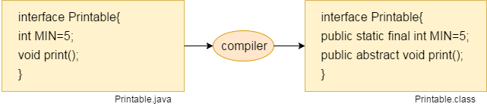
Syntax:
Interface <interfaceName>
{
//statements;
}

Slide 58
Exception Handling

Slide 59
Definition:
Exception is a problem that arise during the execution time
An abnormal event which stops the program abruptly is called Error.
Exception handling is a mechanism to handle errors in the runtime. So that the normal flow of the application is maintained.
Keywords:
1. Try 2. Catch
3. Throw 4. Throws 5. Finally

Slide 60
Types of Exception:
Exception
Built in exception
User defined exception
Arithmetic exception
Array index out of bound exception
Class not found exception
Io exception
Interrupt exception

Slide 61
END

Slide 62
Advance Java
J2EE

Slide 63
Thread

Slide 64
Definition:
A Thread is similar to a Sequential program.
Collection of thread is called as process.
A thread is not a program on its own but runs within a program.
Every program has at least one thread that is called the Primary thread.
A thread is also known as a lightweight processor execution context.
We can create more threads when necessary.

Slide 65
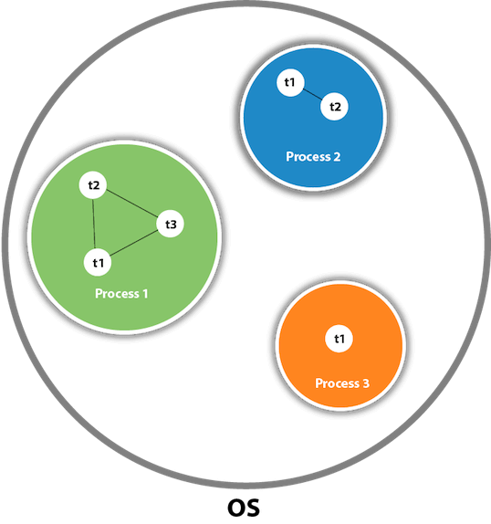
Multitasking:
Process Based:
Collection of thread is known as process.
Thread Based:
Individual thread working on a single program.

Slide 66
Multi-Threading:
Java is a multithreaded programming language.
Multithreading extends the idea of multitasking into applications where you can subdivide specific operations within a single application into individual threads.
Each of the threads can run in parallel.
The OS divides processing time not only among different applications, but also among each thread within an application

Slide 67
Create Thread By:
Implementing Runnable Interface:
If your class is intended to be executed as a Thread then you can achieve this by implementing Runnable interface.
public class Threads implements Runnable
Extending Thread Class:
The second way to create a thread is to create a new class that extends Thread class.
This approach provides more flexibility in handling multiple threads created using available methods in Thread class.
public class threadCls extends Thread

Slide 68
Life Cycle of a Thread:
A thread goes through various stages in its lifecycle.
initialize → start → Runnable →(waiting) → Not Runnable → Dead
Pre-defined Methods:
Start()
Run()
Wait()
Notify()
Sleep()

Slide 69
Daemon Thread:
It provides background support for user threads.
It is a Service provider.
When a user thread dies JVM will terminate the Daemon thread.
To specify or create a daemon thread…
t1.setDaemon(true);
To check whether a thread is daemon or not…
if(Thread.currentThread().isDaemon())

Slide 70
Synchronization:
Thread synchronization is used to run a particular thread without interruption.
It puts the other thread to wait state until that particular thread complete the task.
Keyword: synchronized
Garbage Collection:
It is a thread runs in JVM that deletes the unused objects to free-up some space.
Garbage collector removes the object which is created by “new” keyword
Garbage collector is a daemon thread.

Slide 71
Collections
Util packages

Slide 72
Definition:
The Collection in Java is a framework that provides an architecture to store and manipulate the group of objects.
collection is an object or container which stores a group of other objects as a single unit or single entity.
Java Collections can achieve all the operations that you perform on a data such as searching, sorting, insertion, manipulation, and deletion.
A collection in java is a container object that is used for storing multiple same and different, duplicate and unique elements without any size limitation.

Slide 73
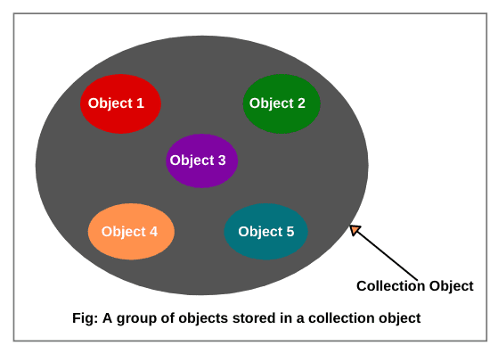
Collections Framework:
JVM stores the reference of other objects into a collection object.
It never stores physical copies of other object.

Slide 74
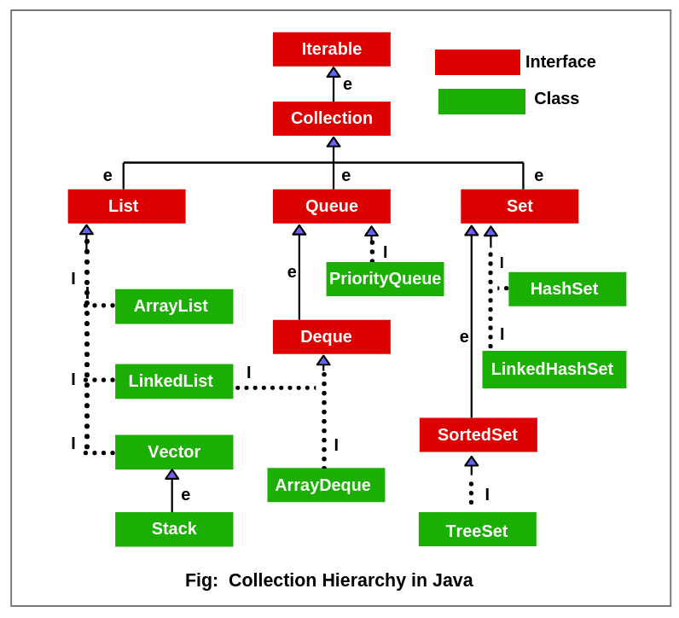

Slide 75
Iterator Interface:
The iterable interface has only one method called iterator().
The function of the iterator method is to return the iterator object.
Collection Interface:
The basic interface of the collections framework is the Collection interface which is the root interface of all collections in the API.
List Interface:
To arrange the elements in sequential order.
We can insert elements into the list at any location.
The list allows storing duplicate elements in Java.

Slide 76
Set Interface:
It is used to store the collection of unique elements.
All the elements in a set can be in any order.
Set does not allow any duplicate elements.
Queue Interface:
A queue is an ordered of the homogeneous group of elements in which new elements are added at one end(rear) and elements are removed from the other end(front).
This interface represents a special type of list whose elements are removed only from the head.

Slide 77
ArrayList:
The ArrayList class implements the List interface and it can be resizable.
It uses a dynamic array to store the duplicate element of different data types.
The ArrayList class maintains the insertion order.
The elements stored in the ArrayList can be randomly accessed.
Syntax:
import java.util.ArrayList;
ArrayList <Datatype> <object>=new ArrayList<Datatype>();
ArrayList<String> obj= new ArrayList<String>();

Slide 78
LinkedList:
It uses a doubly linked list internally to store the elements.
It can store the duplicate elements.
It is faster than ArrayList.
In LinkedList, the manipulation is fast because no shifting is required.
Syntax:
LinkedList <Integer> obj = new LinkedList <Integer>();
obj.add(5);

Slide 79
1 2 3 4 5 6 7
Array List
0 1 2 3 4 5 6
node
Ending and starting will have null value
4
6
9
Address of previous node
Address of next node
LinkedList

Slide 80
HashSet:
HashSet class implements Set Interface.
It represents the collection that uses a hash table for storage.
Hashing is used to store the elements in the HashSet.
It contains unique items.
Syntax:
HashSet<String> set=new HashSet<String>();
set.add(“Ajith");
set.add("Vijay");

Slide 81
TreeSet:
Java TreeSet class implements the Set interface that uses a tree for storage.
Like HashSet, TreeSet also contains unique elements.
the access and retrieval time of TreeSet is quite fast.
The elements in TreeSet stored in ascending order.
Syntax:
TreeSet<String> set=new TreeSet<String>();
set.add("Ravi");

Slide 82
node
1
#6y;
3p-&
FWT$0@
2
3
Hashing
Data
4
6
5
Tree Set
Hash Table

Slide 83
Queue
It follows FIFO concept for insertion and deletion of elements from a queue.
PriorityQueue, ArrayBlockingQueue and LinkedList are the implementations that are used most frequently.
PriorityQueue:
processing the objects on the basis of priority.
It follows FIFO pattern in the Java queue.
However, sometimes the elements of the queue are needed to be processed according to the priority, that's where a PriorityQueue comes into action.

Slide 84
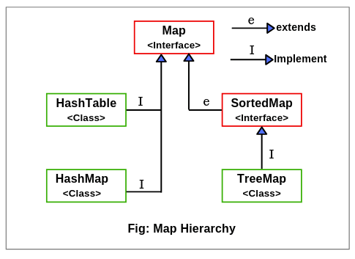
Map Interface:
It represents an object that stores and retrieves elements in the form of a Key/Value pairs
Their location within the Map are determined by a Key.
Map uses a hashing technique for storing key-value pairs.
It doesn’t allow to store the duplicate keys but duplicate values are allowed.

Slide 85
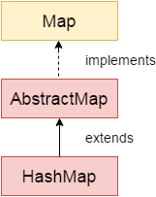
HashMap:
Java HashMap class implements the Map interface which allows us to store key and value pair, where keys should be unique.
it is denoted as HashMap<K,V>, where K stands for key and V for value.
It inherits the AbstractMap class and implements the Map interface.
Java HashMap is non synchronized and it maintains no order.
Syntax:
HashMap<Integer,String> map = new HashMap<Integer,String>();
map.put(1,"Mango");

Slide 86
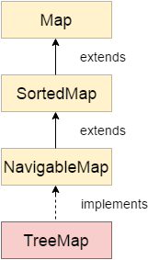
TreeMap:
TreeMap class is a red-black tree based implementation.
It provides an efficient means of storing key-value pairs in sorted order.
It contains values based on the key and only unique elements.
Java TreeMap cannot have a null key but can have multiple null values.
Syntax:
TreeMap<Integer,String> map=new TreeMap<Integer,String>();
map.put(100,"Amit"); map.put(102,"Ravi");

Slide 87
Lambda Method:
A lambda expression is a short block of code which takes in parameters and returns a value.
It is similar to methods, but they do not need a name and they can be implemented right in the body of a method.
Syntax:
parameter -> expression
(parameter1, parameter2) -> { code block }

Slide 88
Lambda with Interface
Lambda expressions can be stored in variables if the variable's type is an interface which has only one method.
The lambda expression should have the same number of parameters and the same return type as that method.
Java has many of these kinds of interfaces built in, such as the Consumer interface (found in the java.util package) used by lists.
Example:
Consumer<Integer> method = (n) -> { System.out.println(n); };
numbers.forEach( method );

Slide 89
Example:
import java.util.ArrayList;
public class Main {
public static void main(String[] args) {
ArrayList<Integer> numbers = new ArrayList<Integer>();
numbers.add(5);
numbers.add(9);
numbers.add(8);
numbers.add(1);
numbers.forEach( (n) -> { System.out.println(n); } );
Consumer<Integer> method = (n) -> { System.out.println(n); };
numbers.forEach( method );
}}

Slide 90
Enum
An enum is a special "class” that represents a group of constants (unchangeable variables, like final variables).
To create an enum, use the enum keyword and separate the constants with a comma. they should be in uppercase letters.
Example:
enum Level { LOW, MEDIUM, HIGH }
Level myVar = Level.MEDIUM;
Note: You can access enum constants with the dot

Slide 91
FILE HANDLING

Slide 92
Definition:
File handling is an important part of any application.
Java has several methods for creating, reading, updating, and deleting files.
The File class from the java.io package, allows us to work with files.
To create a file - createNewFile() method
To write inside file the FileWriter class together with its write() method
use the Scanner class to read the contents of the text file
To delete a file in Java, use the delete() method

Slide 93
To Create:
File <fobj> = new File(<path of text file>);
<fobj>.createNewFile();
To Write:
FileWriter <wobj> = new FileWriter(<fobj>);
<wobj>.write(“Hello”);
To Add:
<wobj>.append(“Wolrd”);
<wobj>.flush(); → Push data into file
<wobj>.close();

Slide 94
To Read:
FileReader <Robj> = new FileReader(Fobj);
Scanner s = new Scanner(Robj);
while(s.hasNextLine()) {
System.out.println(s.next());
}
To Delete:
File <fobj> = new File(<path of text file>);
<fobj>.delete();
To Create Folder:
File <fobj> = new File(<path of folder>);
<fobj>.mkdir();

Slide 95
Serialization & Deserialization:
Serialization in Java is a mechanism of writing the state of an object into a byte-stream.
It is mainly used in Hibernate, RMI, JPA, EJB and JMS technologies.
The reverse operation of serialization is called deserialization where byte-stream is converted into an object.
The serialization and deserialization process is platform-independent, it means you can serialize an object on one platform and deserialize it on a different platform.

Slide 96
Example:
The String class and all the wrapper classes implement the java.io.Serializable interface by default.
For serializing the object, we call the writeObject() method of ObjectOutputStream class.
For deserialization we call the readObject() method of ObjectInputStream class.

Slide 97
Stream API

Slide 98
Stream API
Stream was introduced in Java 8, the Stream API is used to process collections of objects.
A stream in Java is a sequence of objects that supports various methods that can be pipelined to produce the desired result.
Use of Stream in Java:
Stream API is a way to express and process collections of objects.
Enable us to perform operations like filtering, mapping, reducing, and sorting.

Slide 99
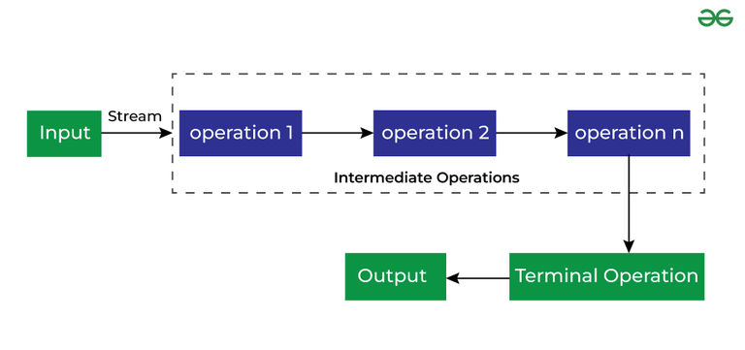
Benefits:
No Storage
Pipeline of Functions
Laziness
Can be infinite
Can be parallelized
Can be created from collections, arrays, Files Lines, Methods in Stream, IntStream etc.
Different Operations On Streams
Intermediate Operations
Terminal Operations

Slide 100
Intermediate Operations:
flatMap(List::stream): Flattens the nested lists into a single stream of strings.
filter(s -> s.startsWith("S")): Filters the strings to only include those that start with "S".
map(String::toUpperCase): Converts each string in the stream to uppercase.
distinct( ): Removes any duplicate strings.
sorted( ): Sorts the resulting strings alphabetically.
peek( ): Adds each processed element to the intermediate Results set for intermediate inspection.

Slide 101
Terminal Operations
forEach(): Prints each name in the list.
Collect(): Filters names starting with 'S' and collects them into a new list.
Reduce(): Concatenates all names into a single string.
Count(): Counts the total number of names.
findFirst(): Finds and prints the first name in the list.
allMatch(): Checks if all names start with 'S'.
anyMatch(): Checks if any name starts with 'S'.

Slide 102
Java Swing

Slide 103
Introduction:
Java swing is used to create window-based applications.
It is built on the top of AWT (Abstract Windowing Toolkit) API and entirely written in java.
Unlike AWT, Java Swing provides platform-independent and lightweight components.
The javax.swing package provides classes for java swing API such as:
JButton, JCheckbox,
JTextField, JRadioButton,
JMenu, JColorChooser etc.

Slide 104
GUI application:
Every application is a collection program but here,we will call as collection of windows(JFrames).
Jframes is a class of javax.swing.
Example:
JFrame f=new JFrame("My Frame");
JTextField jt=new JTextField();
f.add(jt);
jt.setBounds(10, 10, 70, 20);
f.setVisible(true);

Slide 105
Event handling:
Event handling is the mechanism that controls the event and decides what should happen if an event occurs.
This mechanism have the code which is known as event handler that is executed when an event occurs.
Event:
Change in the state of a object is known as event.
Implements → ActionListner
JButton f1=new JButton("submit");
f1.setBounds(10, 600, 90, 30);
f1.addActionListener(this);

Slide 106
LayoutManagers:
The LayoutManagers are used to arrange components in a particular manner.
The Java LayoutManagers facilitates us to control the positioning and size of the components in GUI forms.
LayoutManager is an interface that is implemented by all the classes of layout managers.
Java.awt.BorderLayout
javax.swing.BoxLayout
java.awt.GridLayout
java.awt.CardLayout

Slide 107
JDBC

Slide 108
Introduction:
JDBC stands for Java Database Connectivity.
JDBC is a Java API to connect and execute the query with the database.
JDBC API uses JDBC drivers to connect with the database.
We can use JDBC API to access tabular data stored in any relational database.
By the help of JDBC API, we can save, update, delete and fetch data from the database.

Slide 109
Connecting to Mysql:
Driver class: The driver class for the mysql database is
com.mysql.jdbc.Driver
Connection URL: The connection URL for the mysql database is
jdbc:mysql://localhost:3306/demo
Username: The default username for the mysql database is root.
Password: It is the password given by the user at the time of installing the mysql database.

Slide 110
Example:
Class.forName("com.mysql.cj.jdbc.Driver");
Connection con=DriverManager.getConnection
("jdbc:mysql://localhost:3306/developers","root",“password");
Statement st=con.createStatement();
ResultSet rs=st.executeQuery("select * from demo");
while(rs.next())
{
System.out.println(rs.getString(1)+"\t"+rs.getString(2));
}

Slide 111
Servlet
Servlet is a technology which is used to create a web application.
Servlet is an API that provides many interfaces and classes including documentation.
Servlet is a class that extends the capabilities of the servers and responds to the incoming requests.
It can respond to any requests.
Servlet is a web component that is deployed on the server to create a dynamic web page.

Slide 112
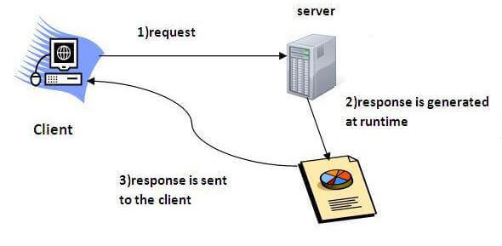
How it Works

Slide 113
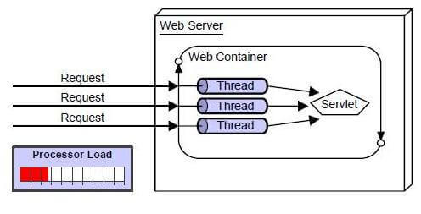
Advantage of Servlet
The web container creates threads for handling the multiple requests to the Servlet.
Better performance: because it creates a thread for each request, not process.
Portability & Secure : because it uses Java language.
Robust: JVM manages Servlets, so we don't need to worry about the memory leak, garbage collection, etc.
(Tomcat)

Slide 114
Java Server Pages(JSP)
JSP is a technology that allows developers to create dynamic web pages using Java and HTML.
JSP is a collection of technologies that combines HTML with Java to create data-driven web content.
How it works:
JSP files contain HTML with embedded Java code.
The JSP engine compiles the JSP page into a Java servlet.
The servlet engine handles the servlet, which creates dynamic HTML and sends it to the browser.

Slide 115
Creating Servlet:
The servlet can be created by three ways:
By implementing Servlet interface,
By inheriting GenericServlet class, (or)
By inheriting HttpServlet class

Slide 116
Creating Servlet:
Sumapp Example(eclipse):
<servlet>
<servlet-name>addition</servlet-name>
<servlet-class>com.webapp.AddServlet</servlet-class>
</servlet>
<servlet-mapping>
<servlet-name>addition</servlet-name>
<url-pattern>/added</url-pattern>
</servlet-mapping>

Slide 117
END

Slide 119
Wrapper Class

Slide 120
Definition:
Converting String Values to different datatypes like Integer, float.
Syntax:
int a=Integer.parseInt(string);
float a=Float.parseFloat(string);

Slide 121
Numbering System Conversion:
Binary Conversion:
String s=Integer.toBinaryString(num);
int num=Integer.parseInt(“s”,2);
Octal Conversion:
String s=Integer.toOctalString(num);
int num=Integer.parseInt(“s”,8);
Hexadecimal Conversion:
String s=Integer.toHexString(num);
int num=Integer.parseInt(“s”,16);

Slide 122
Type Casting:
Widening
Converting small data type to big one.
Narrowing
Converting Big data type to small one.
Example:
int a=5;
byte b=(byte)a;
double c=(a);

Slide 123
Packages

Slide 124
Definition:
It has Pre-defined keywords that defined in Liberaries.
By importing those packages you can access those keywords.
Packages contains classes, interfaces, annotations and these all are contains variables , methods , constants.
There are two types:
Pre-defined packages
User Defined Packages
If any package is design by the user is known as user defined package.

Slide 125
Pre-defined Packages:
These are the package which are already designed by the Sun Microsystem and supply as a part of java API, every predefined package is collection of predefined classes, interfaces and sub-package.
14 pre-defined packages are in java.
1. Java.lang 6. Java.io 11. java.security
2. Java.util 7. java.awt 12. java.times
3. Java.applet 8. java.net 13. java.beans
4. Java.text 9. java.sql 14. java.nio
5. Java.rmi 10. Java.math

Slide 126
Difference:
package keyword and import keyword
Package keyword is always used for creating the undefined package and placing common classes and interfaces.
import is a keyword which is used for referring or using the classes and interfaces of a specific package.
Inheritance and package
Inheritance concept always used to reuse the feature within the program between class to class, interface to interface and interface to class but not accessing the feature across the program.
Package concept is to reuse the feature both within the program and across the programs between class to class, interface to interface and interface to class.

Slide 127
Thread Priority:
Every Java thread has a priority that helps the OS to determine the order in which threads are scheduled.
Java thread priorities are in the range between
MIN_PRIORITY (a constant of 1)
MAX_PRIORITY (a constant of 10).
NORM_PRIORITY (a constant of 5).
Threads with higher priority are more important to a program and should be allocated processor time before lower-priority threads.

Slide 128
Java AWT:
AWT components are platform-dependent. .
AWT components are heavyweight.
AWT doesn't support pluggable look and feel.
AWT provides less components than Swing.
AWT doesn't follows MVC(Model View Controller) where model represents data, view represents presentation and controller acts as an interface between model and view.
Java Swing:
Java swing components are platform-independent.
Swing components are lightweight.
Swing supports pluggable look and feel.
Swing provides more powerful components such as tables, lists, scrollpanes, colorchooser, etc.
Swing follows MVC.

Slide 129
Networking

Slide 130
Introduction:
It’s a concept of connecting two or more computing devices together so that we can share resources.
Java socket programming provides facility to share data between different computing devices.
Java Networking is done by TCP/IP protocols.
Protocols:
A protocol is a set of rules basically that is followed for communication.
TCP: Transmission Control Protocol
UDP: User Datagram Protocol

Slide 131
Network Terminology:
IP Address:
its a unique number assigned to a node of a network e.g. 192.168.0.1.
Port Number:
The port number is used to uniquely identify different applications.
MAC Address:
MAC (Media Access Control) address is a unique identifier of NIC (Network Interface Controller).
A network node can have multiple NIC but each with unique MAC address.
Socket:
A socket is an endpoint between two way communications.

Slide 132
Socket:
Java Socket programming can be connection-oriented or connection-less.
The client in socket programming must know two information:
IP Address of Server
Port number.
Client Socket:
Socket s=new Socket("localhost",6666);
Server Socket:
ServerSocket ss=new ServerSocket(6666);

Slide 133
InetAddress:
Java InetAddress class represents an IP address.
The java.net.InetAddress class provides methods to get the IP of any host name.
Example:
InetAddress ip = InetAddress.getByName("www.google.com");
ip.getHostName();
ip.getHostAddress();

Slide 134
Servlet API
The javax.servlet and javax.servlet.http packages represent interfaces and classes for servlet api.
The javax.servlet package contains many interfaces and classes that are used by the servlet or web container.
The javax.servlet.http package contains interfaces and classes that are responsible for http requests only.
It provides http specific methods such as doGet, doPost, doPut, doDelete etc.

Slide 135
HttpServlet Methods
public void service (HttpServletRequest req, HttpServletResponse res)
dispatches the request to the protected service method by converting the request and response object into http type.
protected void doGet(HttpServletRequest req, HttpServletResponse res)
handles the GET request. It is invoked by the web container.
protected void doPost(HttpServletRequest req, HttpServletResponse res)
handles the POST request. It is invoked by the web container.

